Slide 1
Estimation of Medical Diagnostic Likelihood Ratios Using Artificial Intelligence
M2int lab meeting
Sept 22, 2025
Authors: Paul Chong, MD; Shuhan He, MD; Kian Samadian, MD; Cory Rohlfsen, MD; Brian W. Locke, MD MSCI
Presented by: Brian Locke MD MSCI

Slide 2
Summary: LLMs to Estimate Diagnostic LRs
Problem: Bayesian diagnosis requires usable likelihood ratios (LRs).
Claim: Modern large language models (LLMs) approximate diagnostic LRs with negligible bias and bounded dispersion.
Payoff: Understandable approximate evidence weights for clinical reasoning when empiric ones not availab.e

Slide 3
Bayesian Reasoning
Inputs: pretest probability, clinical finding, LR.
• Mechanic: posterior odds = pretest odds × LR; convert back to probability.
• Why LRs: portable across pretest settings; multiplicative; composable across findings.
• Limitation to flag: dependence among findings can bias serial updates. ￼
Visual: one “odds × LR → posterior odds” strip with 1–2 worked examples.
Notes:
[ ] link to explainer notebook.

Slide 4
Bayes needs explicit evidence weights
Clinicians default to gestalt.
Empiric LRs are scarce, context‑dependent, and slow to produce.
Diagnostic Test Accuracy Studies
Goal: Test whether LLMs can supply valid, auditable LR estimates at scale.

Slide 5
Spectrum Bias
13) Spectrum bias & transportability (concepts)
• Spectrum effect: LR depends on case mix, prevalence, thresholds, and setting; transport is non‑trivial.
• Reported LRs often hide contextual constraints; applying them naïvely can miscalibrate posteriors.
• Implication: both empiric and model‑estimated LRs require explicit context to be clinically safe. ￼
Visual: small schematic: “Study cohort → LR” failing to port to “ED cohort”.
⸻
14) Spectrum bias & transportability (implications for this work)
• Our reference standard lacks per‑study context and CIs; models were not given those contexts either.
• Best use: auditable starting weights plus clinician or system‑level context adjustment.
• Path forward: condition–setting–population prompts; retrieval of context; calibration on local data; explicit uncertainty display.

Slide 6
LR scarcity vs LR necessity
Condition–finding–context space is combinatorially large; exhaustive LR measurement is infeasible.
Diagnostic accuracy studies are costly, slow, and often non‑transportable.
Therefore: inferred LRs are not a convenience but a requirement for scalable Bayesian care.
Hypothesis: LLMs can produce valid, auditable LR estimates to fill the gap.

Slide 7
• Question: Are models parroting or predicting?
• Use LLM‑generated LRs as a priori hypotheses for future diagnostic studies.
• Outcome: Benchmarks for model accuracy and a path to real scientific prediction.
• Preview: Prospective, leakage‑controlled evaluations later in the deck.

Slide 8
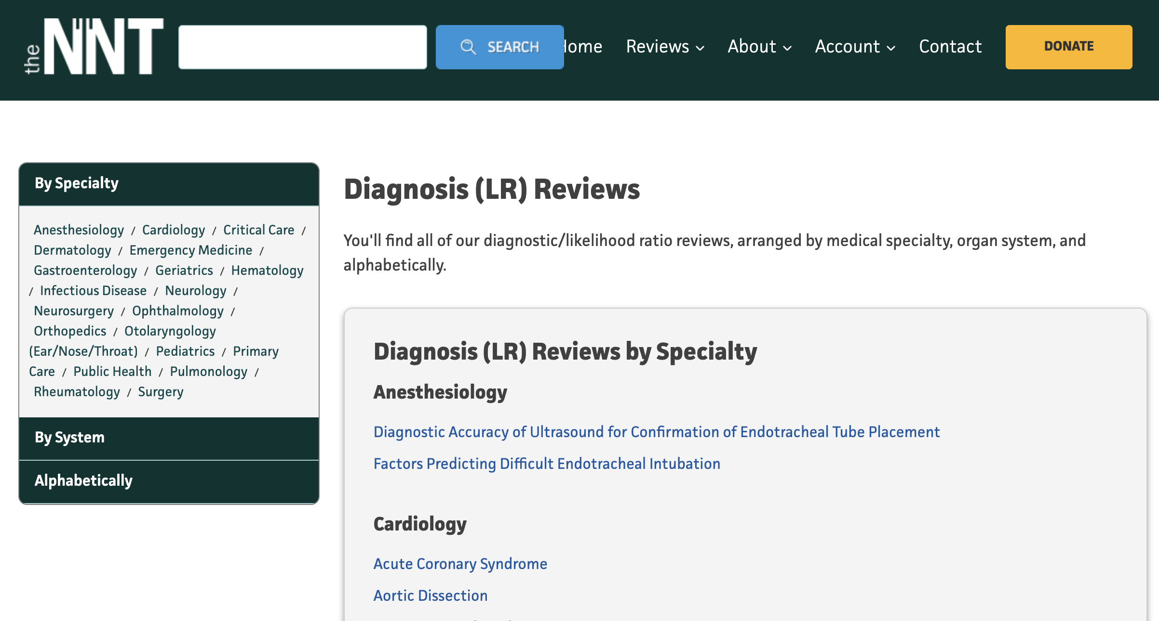
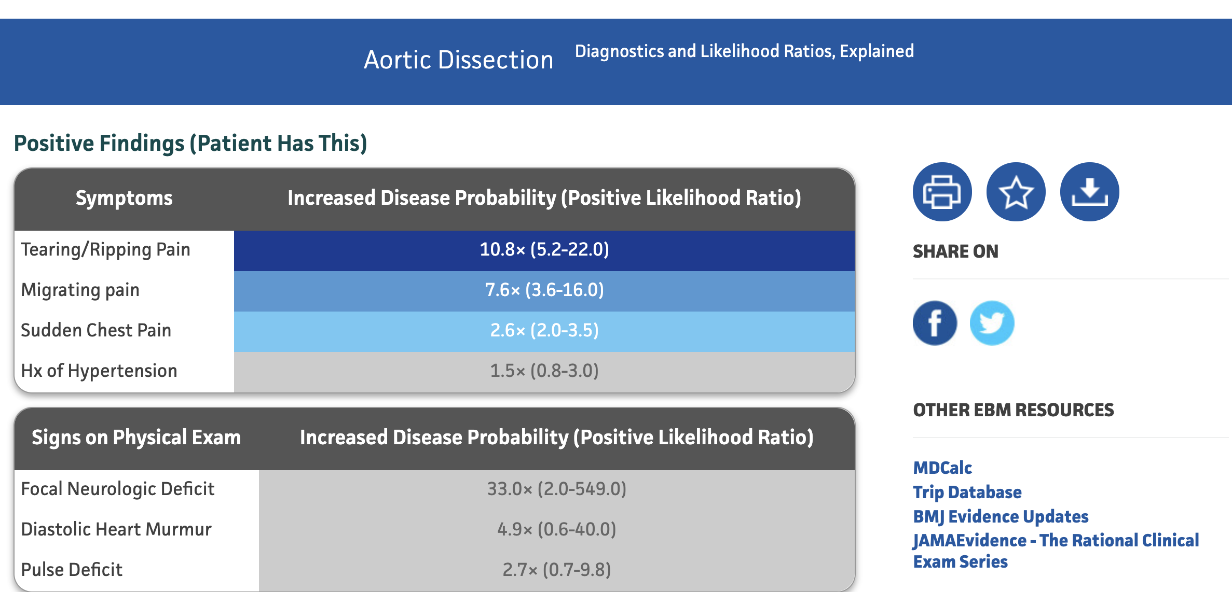
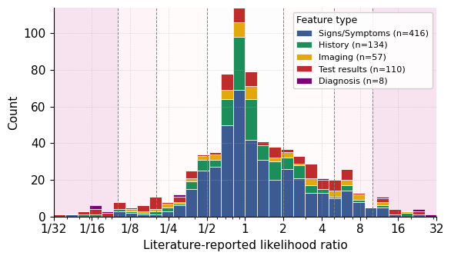
Statistic | Overall | Test results | Imaging | History | Signs Symptoms | Diagnosis
Count | 700 | 110 | 57 | 134 | 416 | 8
Geometric mean | 1.206 | 1.071 | 1.322 | 1.065 | 1.267 | 1.164
5th percentile | 0.190 | 0.060 | 0.200 | 0.226 | 0.360 | 0.064
25th percentile | 0.700 | 0.312 | 0.680 | 0.755 | 0.700 | 0.077
50th percentile | 1.000 | 1.000 | 1.000 | 0.995 | 1.000 | 2.057
75th percentile | 2.200 | 3.675 | 3.300 | 1.675 | 2.100 | 16.300
95th percentile | 7.905 | 15.550 | 12.000 | 5.085 | 7.225 | 26.300
Min | 0.010 | 0.010 | 0.010 | 0.050 | 0.040 | 0.060
Max | 145.894 | 145.894 | 34.400 | 18.500 | 57.000 | 27.000
Notes:
6) TheNNT as a clinical resource
• What it is: Curated diagnostic LRs from the literature for bedside use.
• Why it matters: Clinician‑facing, transparent, broad coverage across common conditions.
• Caveats: Heterogeneous contexts; variable study quality; spectrum/transport issues.
\
Reference set we used (from TheNNT)
700 literature‑reported LRs across 30 conditions; compiled April 1, 2025.
Types represented (not mutually exclusive): signs/symptoms 59% (416), history 19% (134), tests 16% (110).
Distribution: geometric mean 1.21; IQR 0.7–2.2; most LRs cluster near 1 (negligible/weak evidence).

Slide 9
Study design & models
Task: Compare LLM‑estimated LRs to TheNNT values for each finding–condition pair.
Models: GPT‑4o, o3, GPT‑5 (increasing recency/ability).
Date of LLM queries: Aug 25, 2025.
No web access; no fine‑tuning; few‑shot only.
Agreement assessed with Bland–Altman on log‑LR (ratio limits reported)

Slide 10
Prompt Strategy:
System role: “Bayesian diagnostic assistant”; return only JSON {"value": float>0}.
• Definition shown: LR = P(finding | diagnosis) / P(finding | not‑diagnosis).
• Few‑shot: 8 examples for non‑reasoning model; 2 for reasoning models; examples are clinician‑estimated, not scraped.
• Inference: GPT‑4o temperature 0.2; o3/GPT‑5 reasoning effort “medium”; verbosity minimized; structured outputs enforced with schema.

Slide 11
Evaluation metric (how to read the plots)
Bland–Altman on log scale → report multiplicative 95% limits of agreement.
• Mean bias close to 1.0 indicates no systematic over/under‑estimation.
• Narrower limits = closer agreement to literature values across the range.
Notes:
• All models: negligible mean bias (≈1.00×).
• 95% limits of agreement: GPT‑5 ≈ 0.26×–3.70×; o3 ≈ 0.23×–4.28×; GPT‑4o ≈ 0.23×–4.53×.

Slide 12
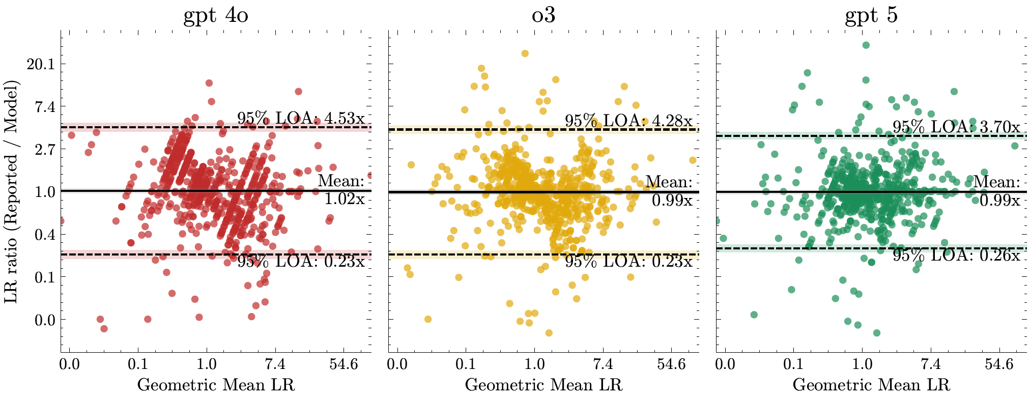
Results
Coverage | Lower edge (95% CI) | Upper edge (95% CI)
50% | 0.63x (0.59x - 0.66x) | 1.56 (1.47x - 1.65x)
75% | 0.46x (0.43x - 0.49x) | 2.15 (2.01x - 2.29x)
90% | 0.33x (0.30x - 0.35x) | 2.99 (2.77x - 3.23x)
95% | 0.26x (0.24x - 0.29x) | 3.70 (3.40x - 4.03x)
99% | 0.17x (0.16x - 0.19x) | 5.61 (5.05x - 6.22x)

Slide 13
Qualitative Agreement
Notes:
Newer model tighter dispersion; qualitative category agreement substantial (GPT‑5 κ≈0.78).

Slide 14
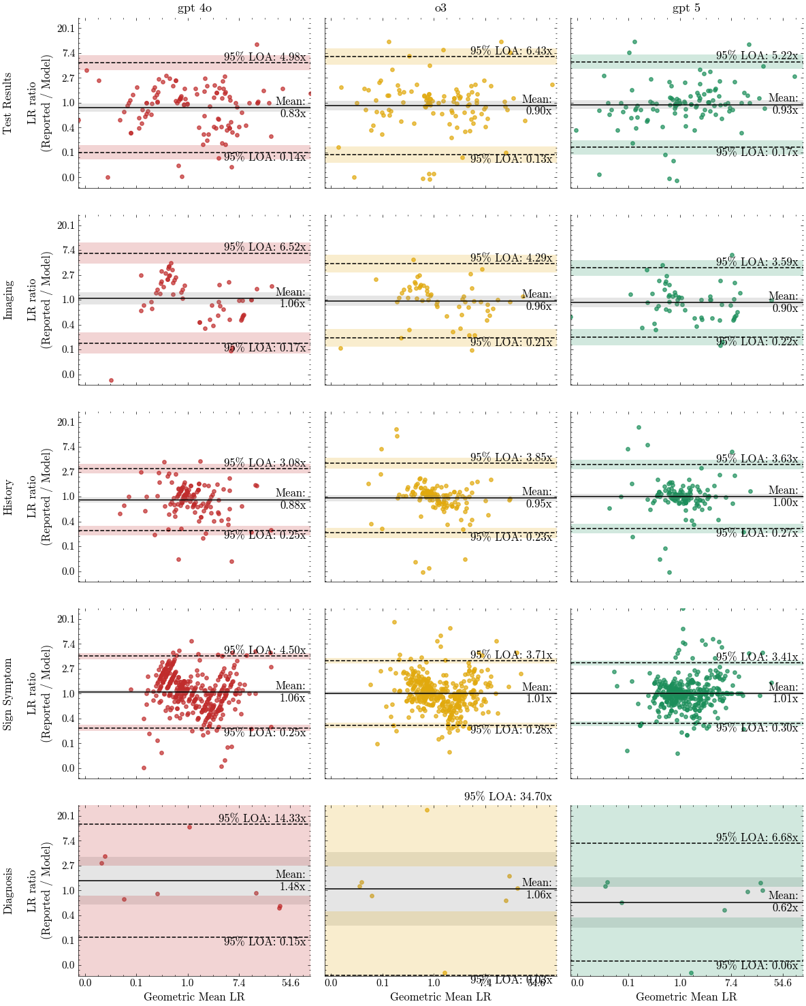
Results

Slide 15
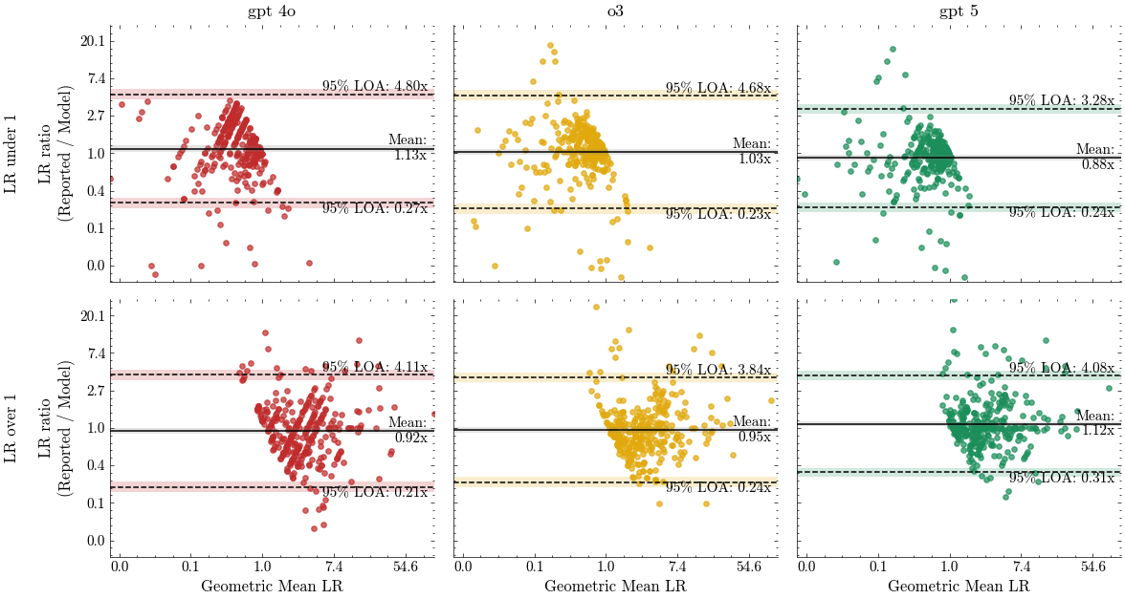
Results

Slide 16
Results

Slide 17
Conclusions

Slide 18
Limitations
Contamination risk → prospective benchmarks → clinical impact
Contamination: TheNNT LRs likely present in pretraining; some agreement may reflect prior exposure.
Remedy: leakage‑controlled, embargoed targets; preregistration; measure true prospective prediction.

Slide 19
Implications
Clinical takeaway: LLM‑estimated LRs can act as auditable evidence weights for Bayesian updating; use serially, not as single decisive tests; integrate with teaching and decision support now, validate prospectively for discovery later.

